Slide 2
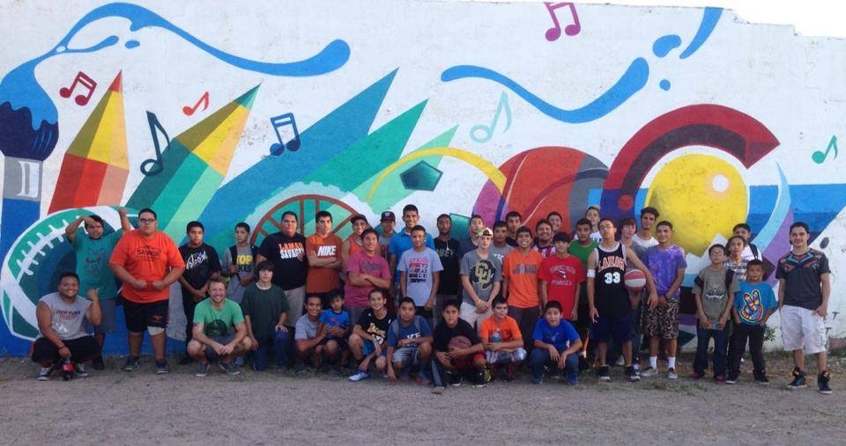
“Rise Above Colorado is a drug abuse prevention organization that measurably impacts teen perceptions and attitudes about the risks of substance abuse to help youth make empowered, healthy choices.”

Slide 3
Objectives
Review the data and facts describing teen substance misuse
Explain how perceptions shape our behaviors
Build critical thinking skills for interpreting the world around us with an open mind
Discuss hopes and concerns around Colorado teen substance misuse
Plan ways to correct misperceptions and rise above substance misuse

Slide 5
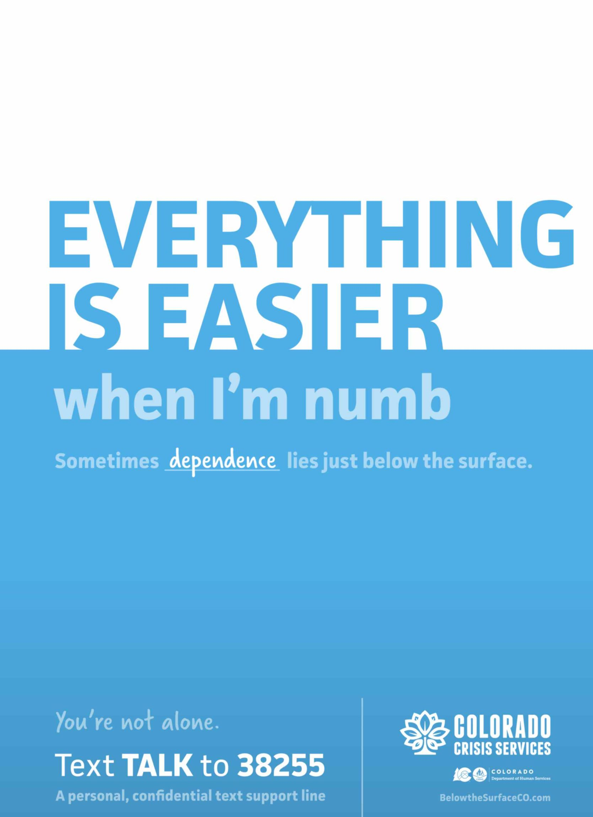
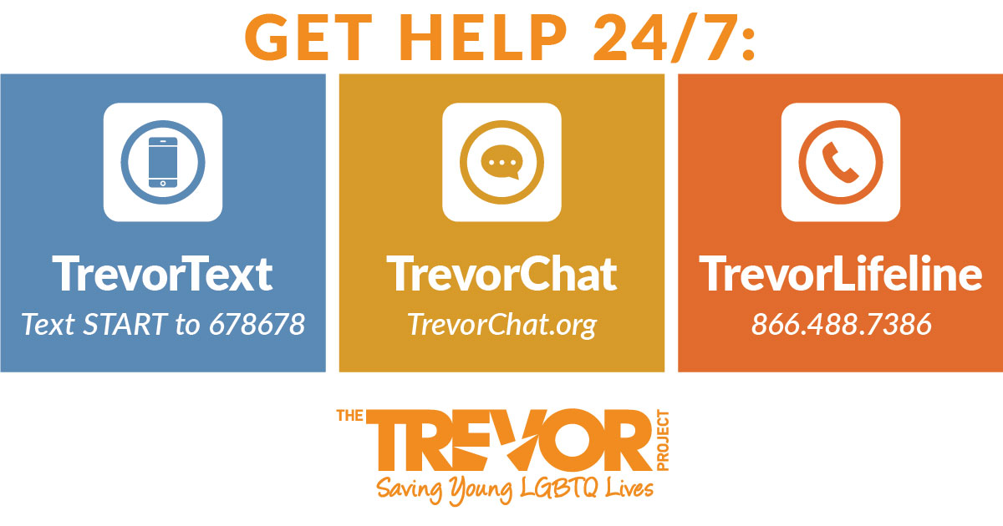

Slide 6
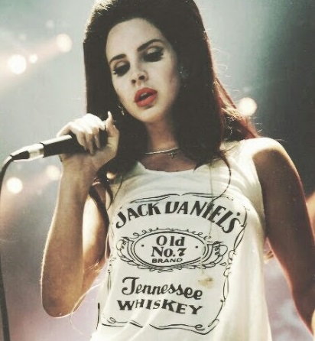
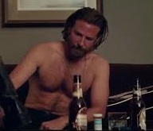
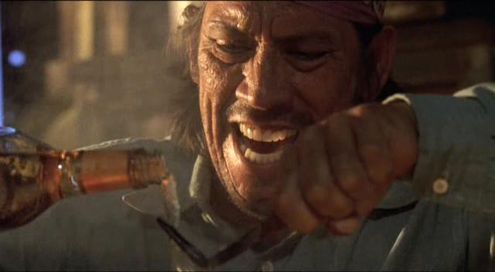

Slide 7
How do you define PERCEPTION?

Slide 8
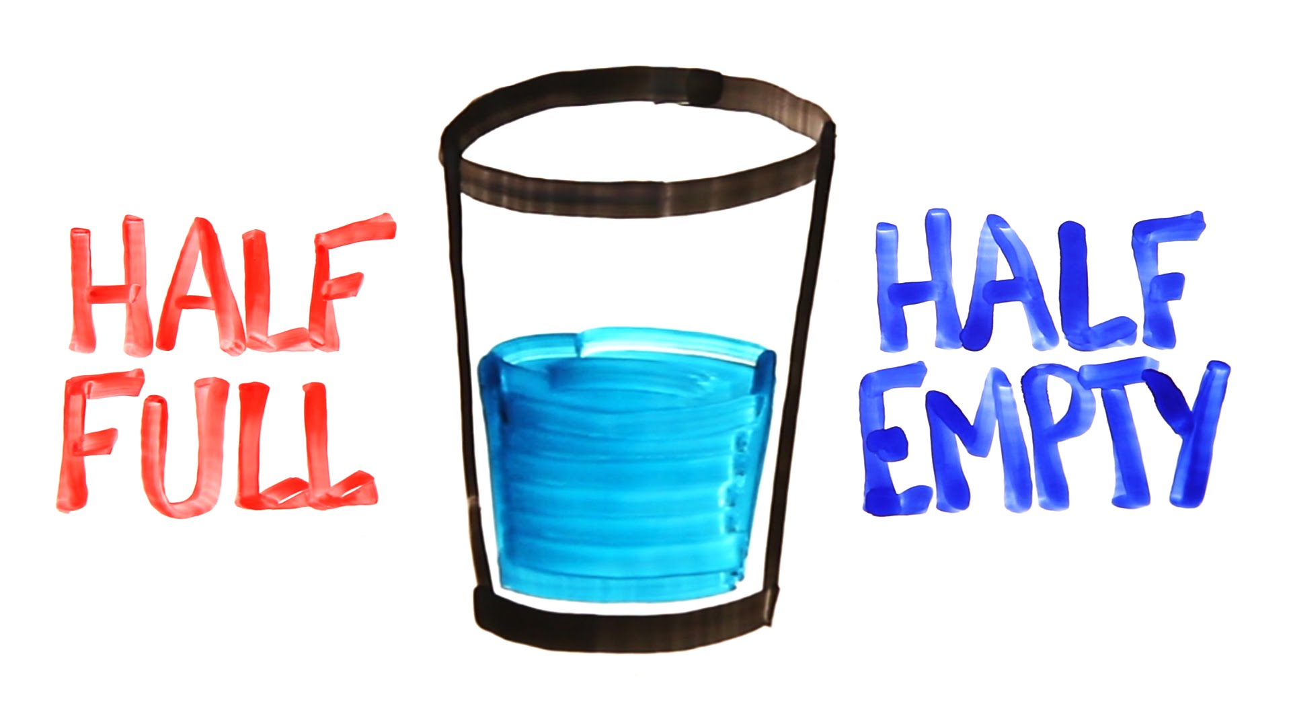
Where do our perceptions come from?

Slide 9
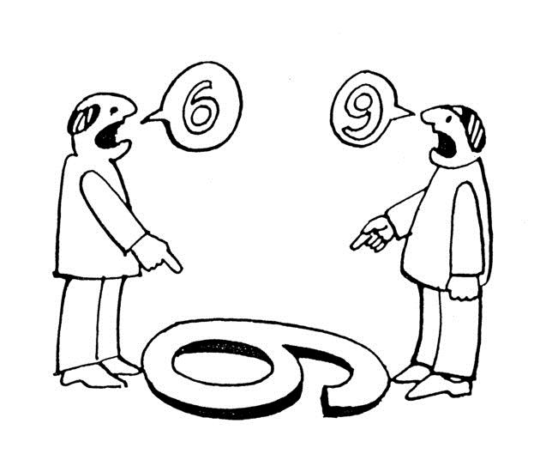
Does this mean that the FACTS are different for each of us?

Slide 11
Perception is NOT always reality.

Slide 12
Social Media is NOT always reality

Slide 13
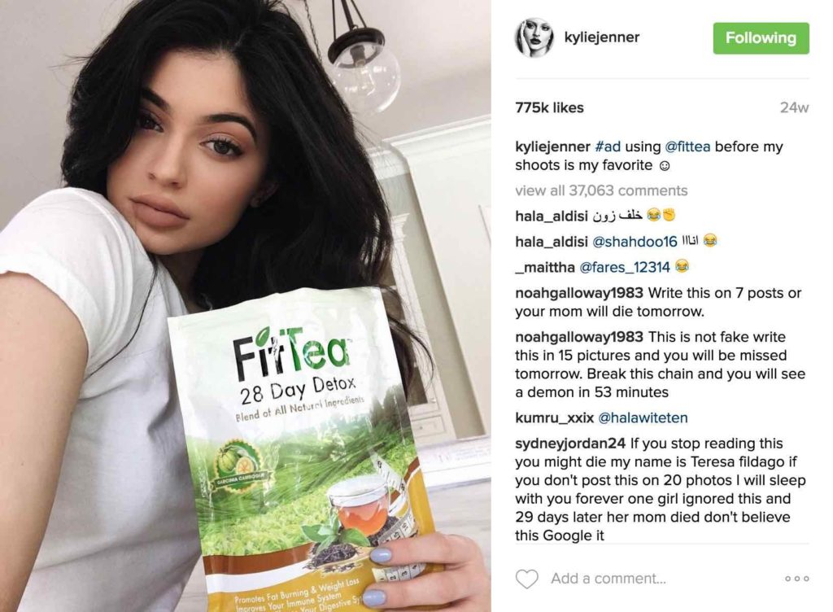
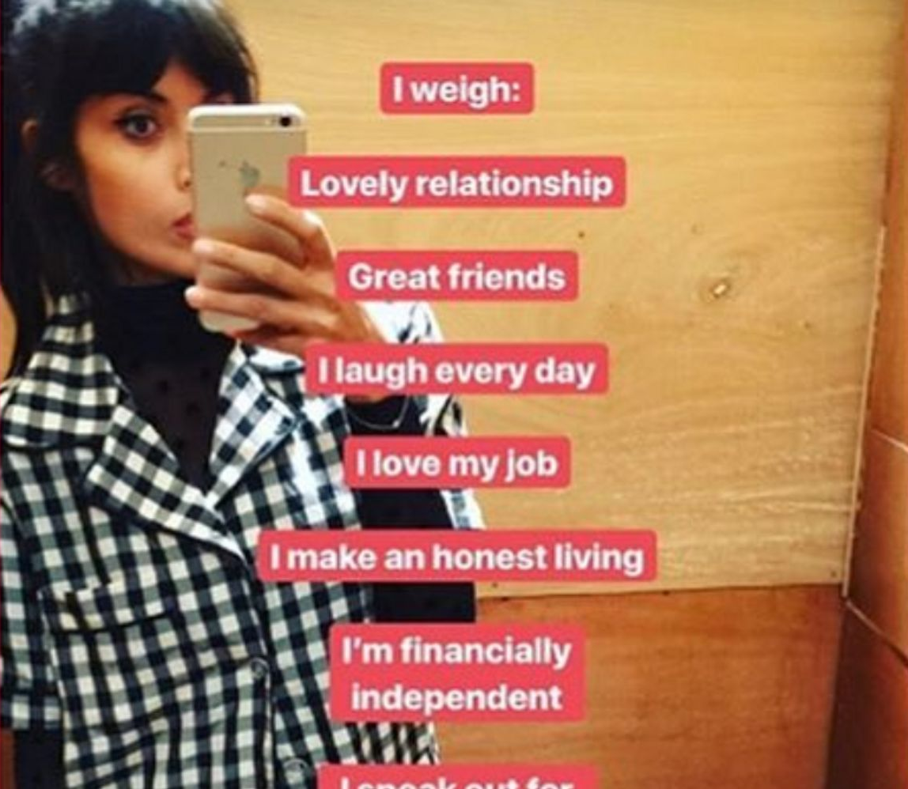
Social Media is NOT always reality

Slide 14
Why is it important to have an accurate perception
of the world around us?

Slide 15
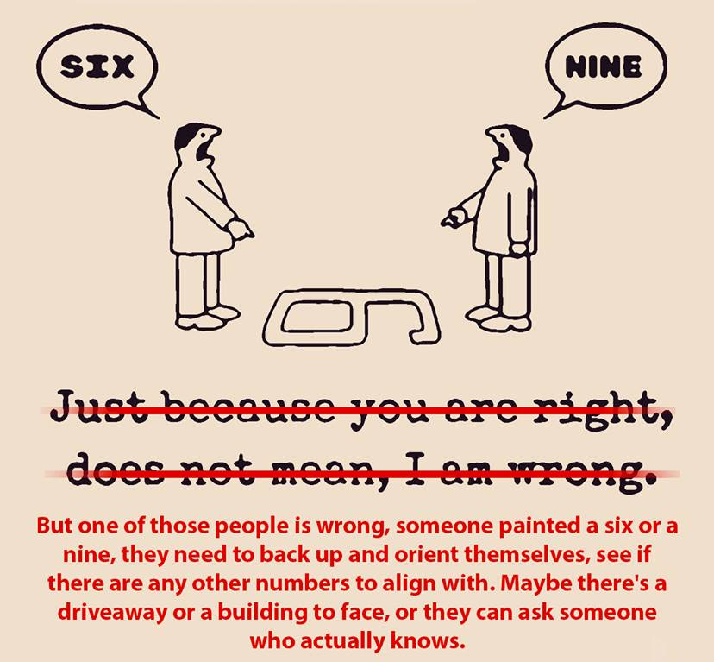
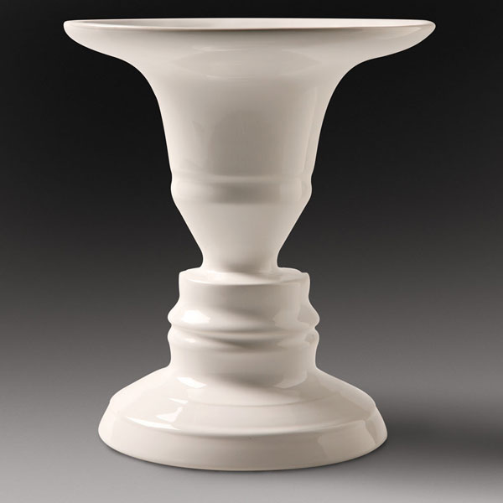
Use DATA and FACTS to understand reality.

Slide 16
Observation First.
Question Next.
Interpretation Last.

Slide 17
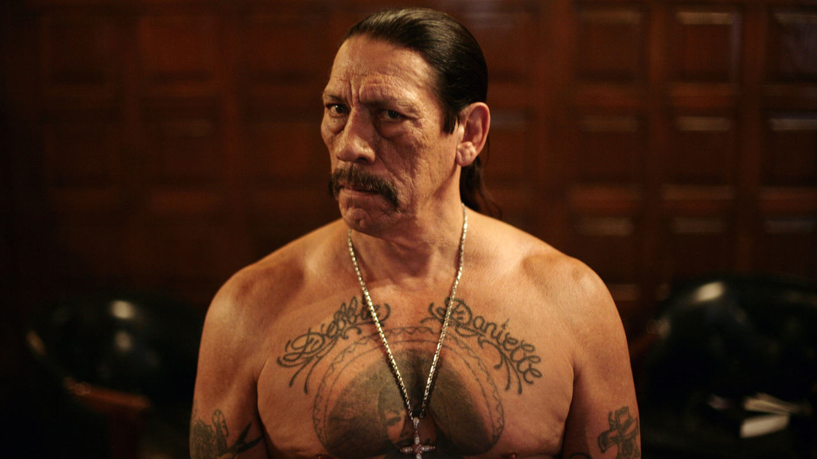

Slide 18
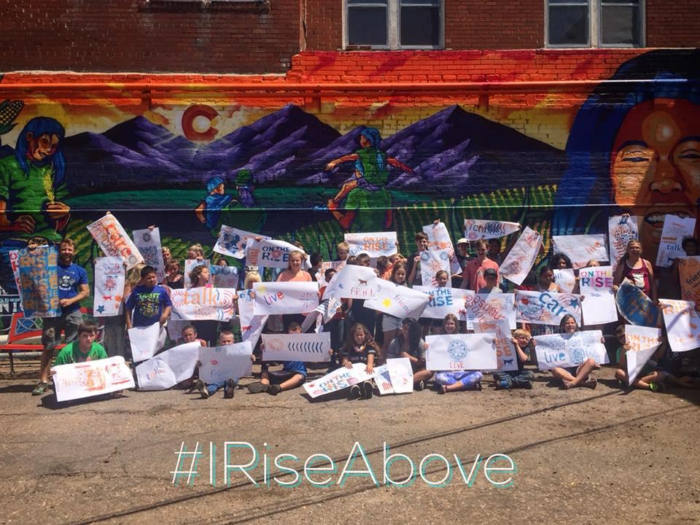
What is RACYS?

Slide 19
 | Healthy Kids Colorado Survey | Rise Above CO Youth Survey
Age | 6-8 grades, 9-12 grades | 12-17 years
Last year of collection | 2019 | 2020
Data collection method | Paper/pencil at school | Online and phone survey
Sample size | 53,000 students from randomly selected middle & high schools | 600 + total (more than 300 reached online)
Sampling design | Representative of CO public middle/high school enrollment | Representative of 2010 Census by county/6 OBH Regions
Areas of focus | Comprehensive Health & Wellness | Behavioral Health
Notes:
Ask if some students recall taking Healthy Kids Colorado Survey in school. HKCS is long and asks about health broadly – from seatbelts, to sex, to drugs. RACYS just looks at substance use and factors that can contribute to use.
You see some differences in data from each survey; however overall trends are comparable indicating that there is validity in both.
HKCS data tends to see higher rates, some of which is due to their sample being older. They mainly report on their high school data alone whereas the Rise Above Colorado Youth Survey reports on data from 12-17 year olds. RACYS doesn’t even survey 18 year olds.
Note: critical thinkers, esp teens, will doubt the validity of the data. The fact that multiple surveys are finding similar results lends much credibility. However, with self-report data, there’s always that limitation of participant honesty and for sure, there’s always a few but they usually aren’t enough of them to sway the results much at all.

Slide 20
Perception, Reality, & Behavior
"The Gap" or misperception

Slide 22
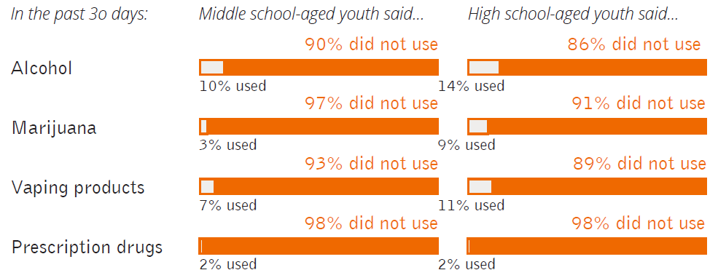

Slide 24
What factors
contribute to teens
misusing substances?

Slide 25
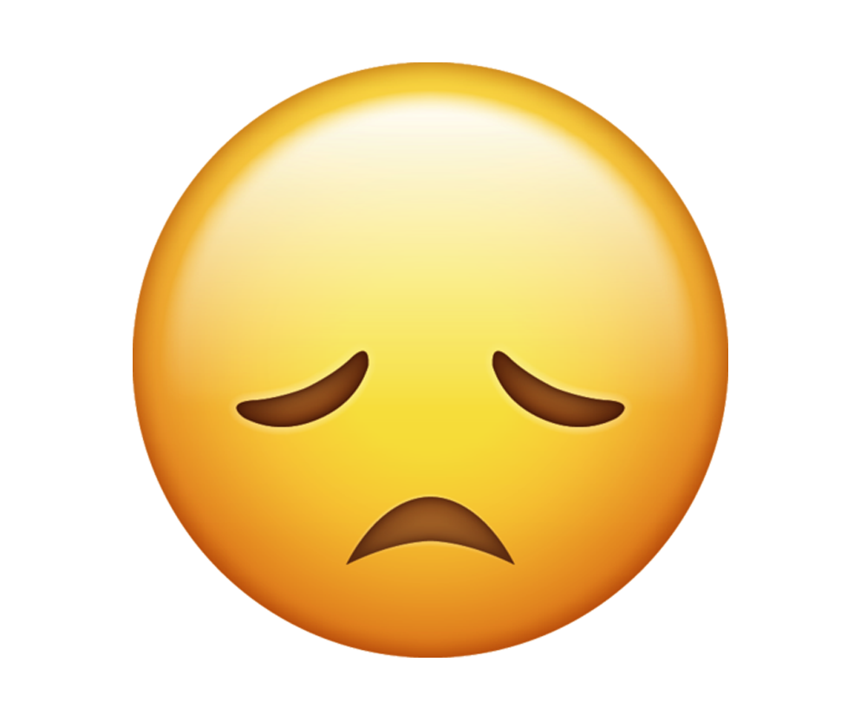
Family history of addiction
Environment
Media
Poor mental health
Trusted adults
Positive peers
Future goals
Hobbies and passions
Community connections
Stress management skills

Slide 26
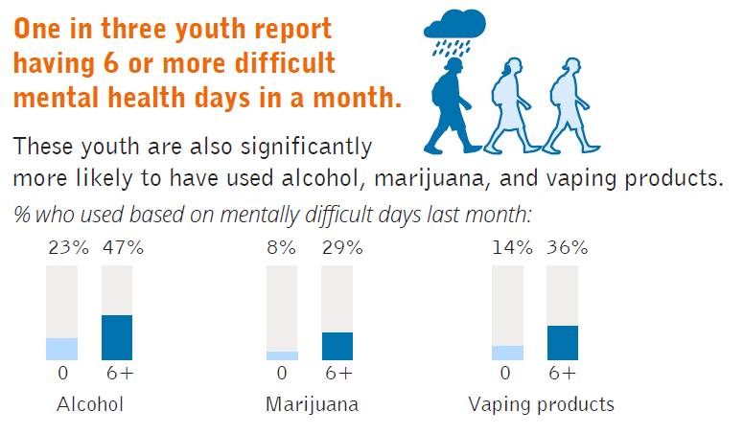

Slide 27
What concerns do you have after reviewing this data? What makes you hopeful?
Why do you think misperceptions around teen substance misuse tend to grow with age?
What information do teens typically use to form their perceptions and opinions? How can we use “Observe, Question, Interpret” to avoid forming misperceptions?
Looking at the factors that protect young people from substance misuse, which do you believe have the most potential for making positive change in your community?

Slide 28
What are actions YOU can take to change the misperceptions among your friends, schoolmates, family and community?

Slide 30
Check out youth resources & campaign updates: www.IRiseAboveCO.org
Share your story and/or highlight positivity from your community:
www.iriseaboveco.org/submit-your-story
Connect with Rise Above Colorado on social media: #IRiseAbove

